Slide 1
Introduction to Machine Learning
What is Machine Learning?
Machine Learning Workflow
Supervised vs. Unsupervised
Regression vs. Classification

Slide 2
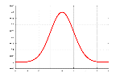
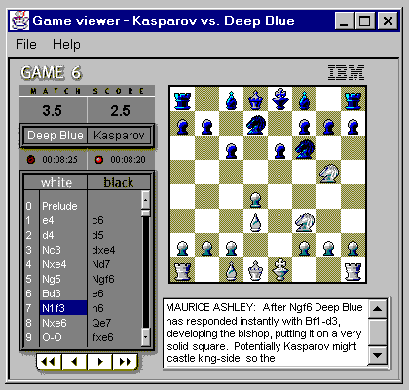

A few definitions upfront...
Probability Theory,
Artificial Intelligence
Machine Learning
Deep Learning
The mathematics behind random and systematic variation
Attempt for machines to imitate cognitive functions we associate with humans (e.g, perceiving, problem solving, learning)
Is an application of AI
Algorithms that allow computers to learn a task with minimal ingoing instructions
Subset of machine learning
Process richer data sets with less pre-processing by humans (e.g. images, raw machine data, etc.)
SOURCE: Nvidia, Internet research, 1: Graphical Processing Units, 2: Amazon Web Services (First major cloud computing service)

Slide 3
What is Machine Learning?
” Field of study that gives computers the ability to learn without being explicitly programmed.” Arthur Samuel
" Machine learning (ML) is the scientific study of algorithms and statistical models that computer systems use to effectively perform a specific task without using explicit instructions, relying on patterns and inference instead. "
SOURCE: Coursera, Andrew Ng https://xkcd.com/1838/

Slide 4

What is Machine Learning?
” Field of study that gives computers the ability to learn without being explicitly programmed.” Arthur Samuel
" Machine learning (ML) is the scientific study of algorithms and statistical models that computer systems use to effectively perform a specific task without using explicit instructions, relying on patterns and inference instead. "
SOURCE: Coursera, Andrew Ng https://xkcd.com/1838/

Slide 5
Why should I care?
Every day, we create 2.5 quintillion bytes of data.
To put that into perspective, 90% of the data in the world today has been created in the last two years alone¹
1 https://www.ibm.com/downloads/cas/XKBEABLN
2 https://www.forbes.com/sites/louiscolumbus/2018/05/23/10-charts-that-will-change-your-perspective-of-big-datas-growth/#5116b7622926

Slide 6
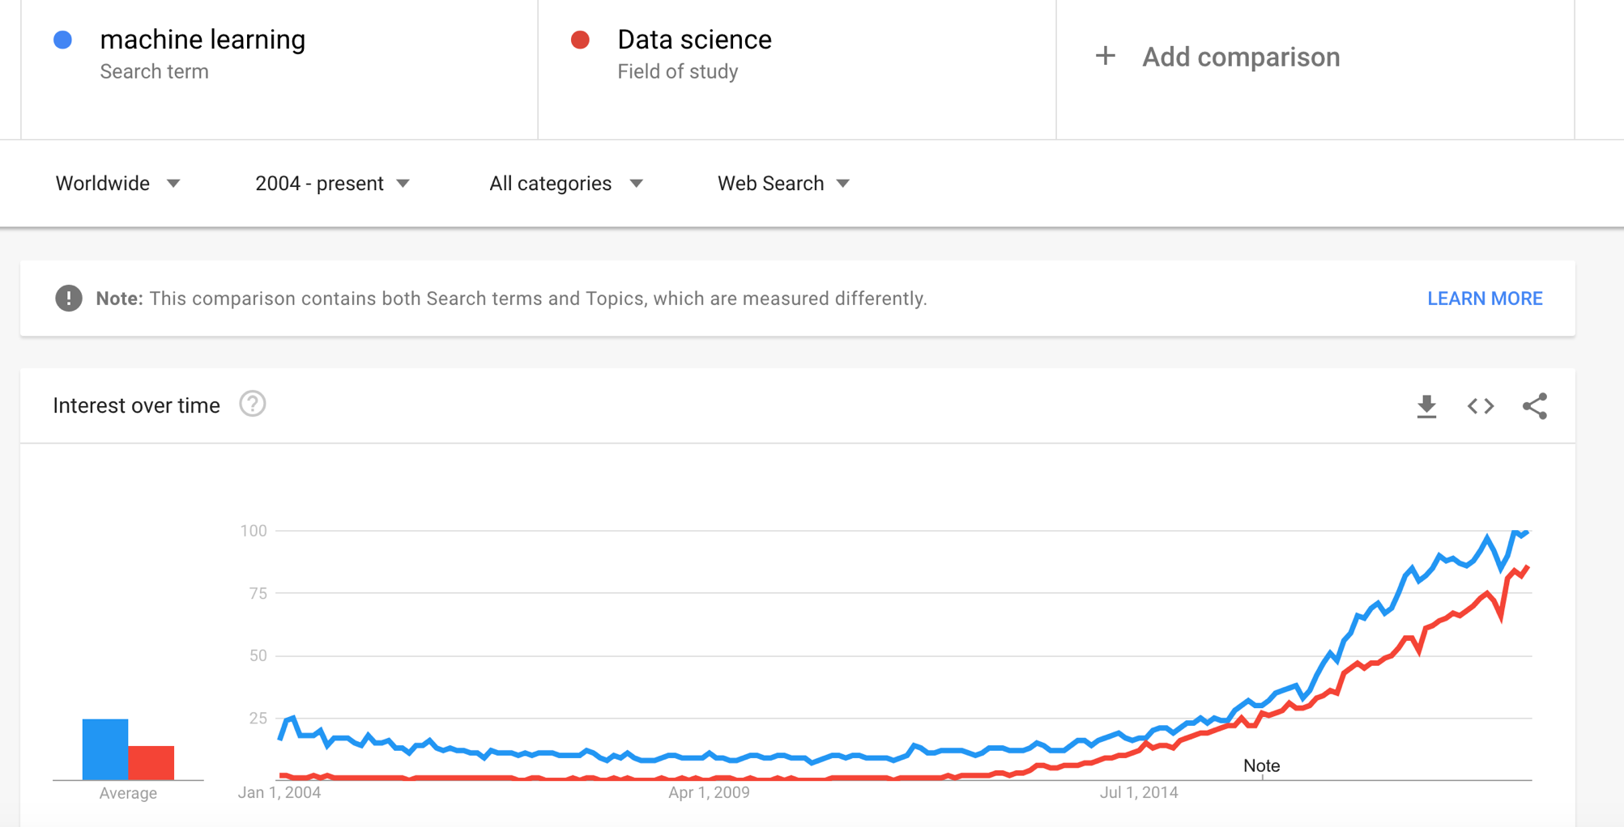

Slide 7
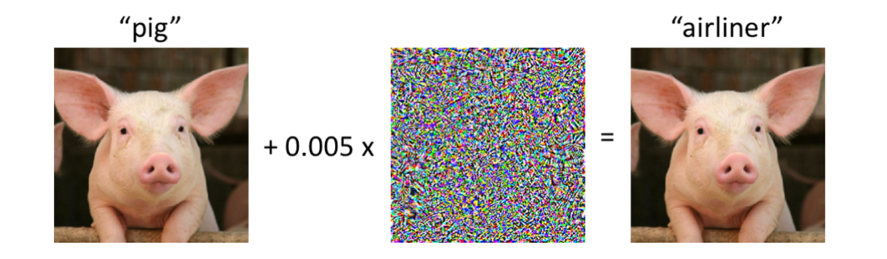
What can ML do? (also, ML is hard)
Facial recognition
Spam detection
Medical diagnosis
Fraud detection
Credit Scoring
Market pricing models
Online recommendation
Language translation
Sentiment Analysis
Autonomous vehicles

Slide 8















Real life applications
Advanced Industries
Financial Services
Healthcare
Elite sport
Automotive
Getting parts right the first time
Financial Information Provider
Validating R&D concepts with data
Pharmaceutical
Optimising how drugs are brought to market
Basketball
Quantifying team chemistry to build better basketball teams
Semiconductor Manufacturer
Reducing defects in the manufacturing process
Retail Bank
Increasing in-store mortgage conversions in the digital age
Hospital Efficiency
Increasing theatre utilisation without compromising quality
Formula One
Combining image processing techniques to design a new way of measuring pit stop duration
Computer Manufacturer
Improving efficiency in design and engineering
Global Information Provider
Harnessing the power of consumer information
Pharma Sales
Understanding sales force effectiveness
Premiership Football
Improving injury prediction
Mining
Improving asset and engineering productivity
Payments Network
Identifying questionable transactions to protect banks and consumers
Government
Assessing the impact of air quality on city residents

Slide 9








Not just for Data Scientists
We blend domain expertise, design, engineering and analytical skills to bring a new perspective
Client Services Lead
Works with clients, engineering, and design to identify requirements and potential solutions and communicates those to the client
Designer/Front End
Graphically represents insights, designs data visualisations and tools to effectively convey results
Data Engineer
Extracts, wrangles, cleanses and links data, and presents the data in a form ready for analysis
Engagement Manager
Leads the day to day of a project, guides team members, and owns the project’s deliverables
Data Scientist
Writes and optimises Machine Learning and Statistical algorithms, explains findings and predicts results
Strategist
Understands the bigger picture, analyses resources, and sets priorities
Information Security
Ensures alignment with security policies and data management approach
Machine Learning Engineer
Links Data Scientists and Data Engineers, writes scalable and highly efficient code developed by the Data Scientists in a production environment

Slide 10

What Data Scientists do…
Translate a business problem.
Use advanced analytics methods to solve complex problems
Explain findings from the model and translate into actionable business insights
Research state-of-the-art domain-specific methods (R&D)
Business Understanding
Data Understanding
Data Preparation
Agile Data Science
Deployment
Sprint and Iterations
Gradual improvement
Patience!
Data
Modelling
Evaluation

Slide 11
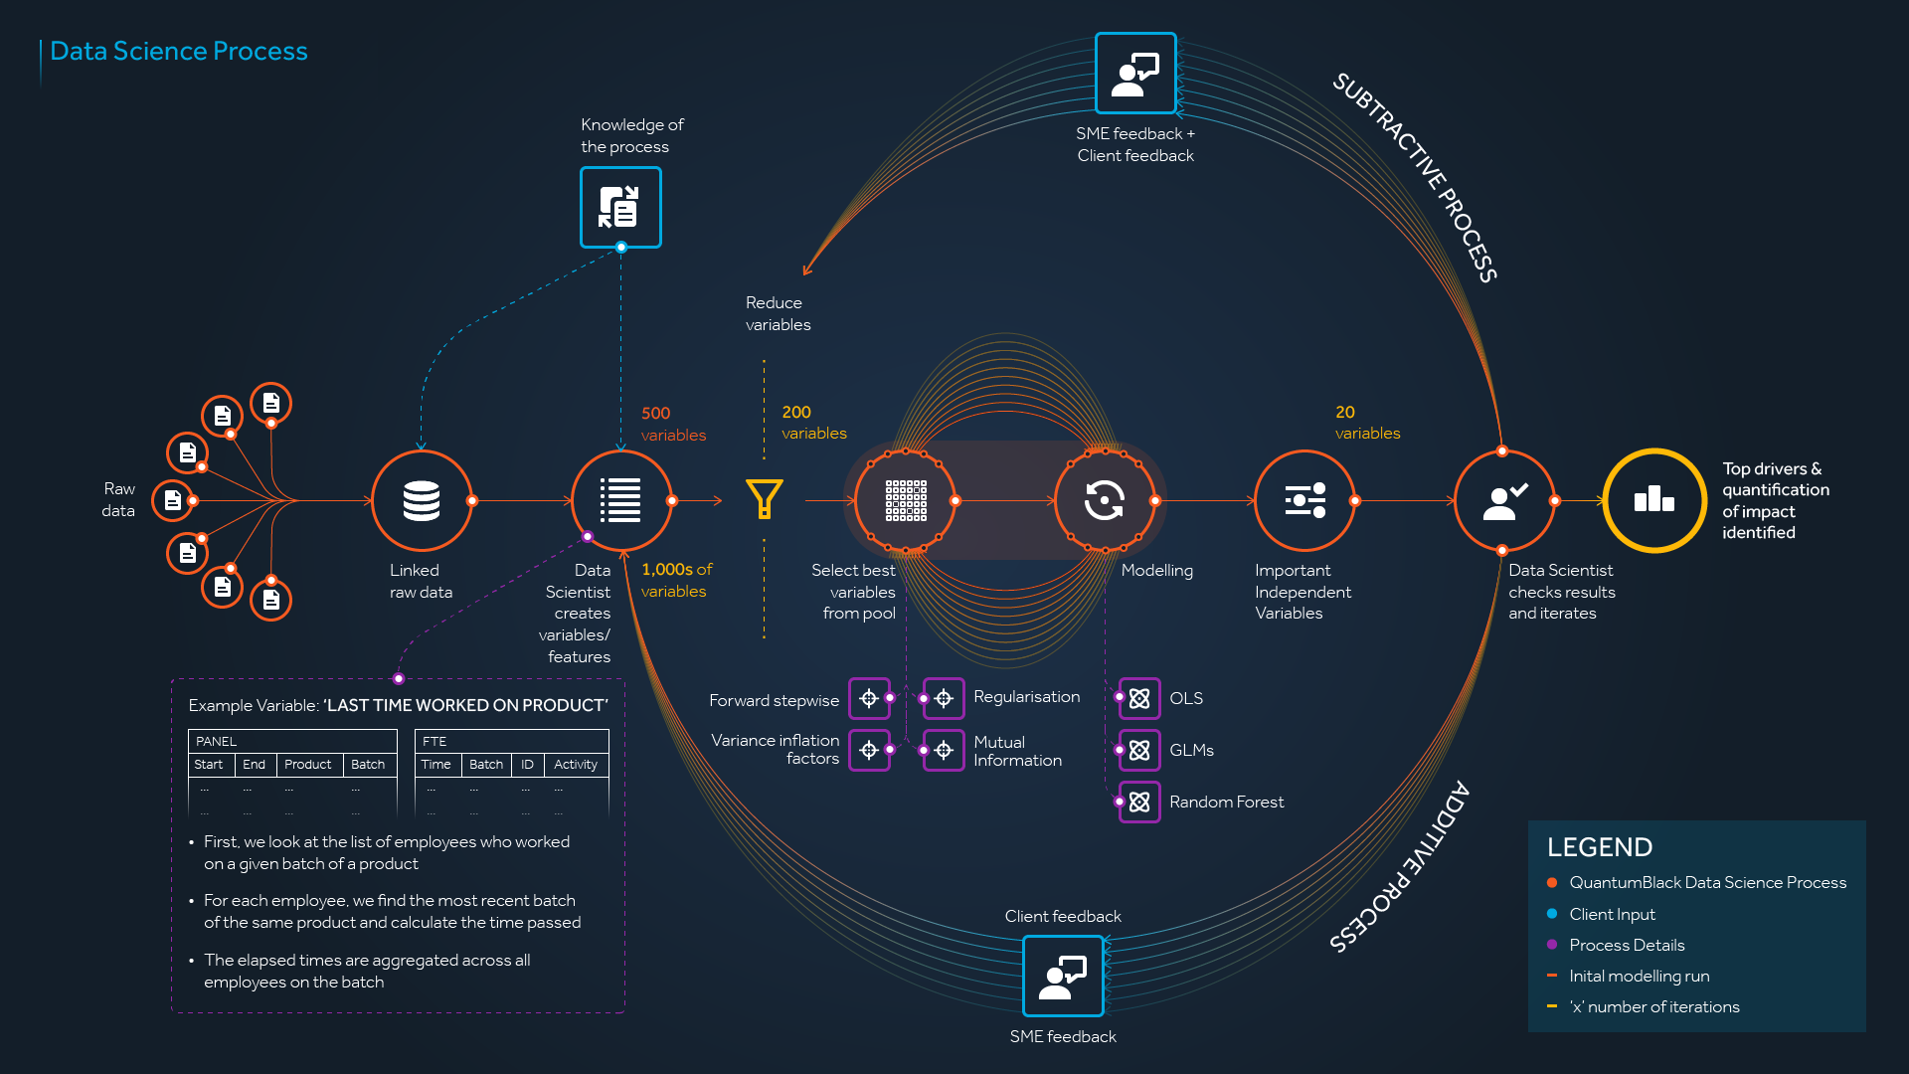

Slide 12







Technology Stack
Languages
Development tools
Data Platforms
Data exploration & visualisation
Distributed Computing
Version control
ML & AI tools

Slide 13
Modelling techniques can be described according to multiple dimensions
Y
Supervised vs. Unsupervised
?
Y = f(x)
Univariate vs. Multivariate
Y = f(x₁, x₂, …)
Linear vs. Nonlinear
Regression vs. Classification

Slide 14



Supervised vs. unsupervised
Supervised Learning (Classification Algorithm
Unsupervised Learning (Clustering Algorithm
Duck
Duck
Supervised Learning
Predictive Model
Not Duck
Unsupervised Learning
Not Duck
Predictive Model
Duck
Western Digital
When to use it
You know how to classify the data, but you want the machine to do it for you
You do not know how to classify the data, and you want the machine to find the classifier for you
How it works
Person labels input data with desired output
Machine gets unlabeled input data
Machine gets labeled training data and infers how to label data
Machine infers hidden structure from data
Machine predicts outputs for new data based on inferred model
Machine returns the structure and classifies data according to that structure
SOURCE: Team analysis

Slide 15
Regression vs Classification
Regression
What is the temperature going to be tomorrow?
Prediction
84˚
Fahrenheit ˚F
Classification
Will it be Cold or Hot tomorrow?
Prediction
COLD
HOT
Fahrenheit ˚F

Slide 16


Machine Learning techniques can be broadly split into three buckets…
Explanatory
Gain insight from historical data
Predictive
Make predictions about future events
Prescriptive
Make decisions to gain an advantage
‘What happened in the past’
‘Why did it happen?’
‘What will happen?’
‘How can we make it happen?’
:Li
Clustering / Segmentation
Correlation & Factor Analysis
Causal Inference
Classical Single Learner (e.g., linear regression)
Advanced Single Learner (e.g., neural networks)
Ensemble Learner (e.g., random forest)
Simulation
Recommendation (collaborative filtering)
Optimisation (simplex, non-linear optimization)
Notes:
Covered in Masterclass -> make link “As you know from yesterday”
There is a tradeoff between interpretable models and high-performance models
More advanced predictive models are more complex internally (more parameters), and thus are far less interpretable than models which are simpler (few parameters)
Prescriptive models have traditionally been relatively simple, but are becoming the ‘next frontier’ of analytics.
As we develop powerful models, we must ensure we can act on these predictions to maximize value-capture within strict business constraints

Slide 17
… but, reality is much more complex
Explanatory
Predictive
Prescriptive
Logistic Regression
HMMs/CRFs
Reinforcement Learning
Classification
Decision Trees
Linear SVM
Bayesian Networks
Non-Linear SVM
CNNs
What group does this sample belong to?
Q-Learning
TD-Learning
Mixed Effects Models
Explainable AI
Gradient Boosted Trees
Random Forest
Neural Networks
SARSA
TRPO
Elastic Net
Genetic Optimization
Regression
What value would this sample take based on the data?
Linear Regression
Survival Models
Generalized Linear Models
Non-Linear Optimization
Gaussian Processes
LP Optimization
KNN
Autoencoders
X-Means Clustering
Variational Autoencoders
Greedy Algorithms
Unsupervised
Anomaly Detection
NMF
What are the hidden / underlying patterns in my data?
Treatment-Effect Models
K-Means
ICA
GMMs
PCA
LDA
t-SNE
Manual Decision Trees/Rules
Notes:
Explain X-AI is state-of-the-art research that can provide some level of explainability for very complex high-performing models
~12000 papers published ever year in Machine Learning, with many proposing their own algorithms
Complex prescriptive algorithms (reinforcement learning) have recently made the news, beating humans both at board-games such as Go and complex computer games such as Starcraft

Slide 18
Now that we know more about our data, let’s see how we can make predictions
Y
Task
Predict events/behaviours in the future
Example
When will machine break?
Output
Predicted time and uncertainty of prediction
Next steps
Use forecasts on ongoing basis to drive decision making
X
SOURCE: McKinsey Analytics Practice

Slide 19
Data partitioning is performed to find the “sweet spot” between over and under fitting a model
Underfitting
Sweet spot
Overfitting
Y
Y
Y
X
X
X
Poor generalisation as it fails to describe trends and relationships in the data
It is often a result of too simplistic models (e.g., not enough variables) or inadequate algorithms used (e.g., linear regression in non-linear data)
Good generalisation power, i.e., model will be able to infer conclusions with new data
Adequate amount of observations, variables and model complexity is required to select the best model – it is an iterative process to find the “sweet spot”
Poor generalisation, i.e., under perform when model sees new data
Happens normally due to high model complexity and inadequate training data (e.g., all the “noise” is being modelled)
SOURCE: McKinsey Analytics Practice

Slide 20
Data is typically split into training and test sets
Testing
Training
Dataset volume
Objectives
Raw data is split into 2 partitions, a training set and a testing set
The training set is used to develop a model, e.g., in a regression the model will use the target variable Y and the predictor variables X1, X2, X3 …, Xn to build a linear relationship in the form of Y = a + a1 X1 + a2 X2 … an Xn
The model developed is then applied in new predictor variables X1’, X2’, X3’ … Xn’ contained in the test set
As the model has never seen the X’n variables before, the performance on the test set, measured by the difference between Y’n in the test set and the predicted Y’n by the model is a good indication of how the model will perform with completely new data
Typical ratios are 90:10; 80:20; 70:30; for train:test split, dependent on the quantity of data available¹
Raw data
Partitioned data
1 As a rule of thumb the test set size should be ~1/$\sqrt{n}$ where n is the amount of adjustable variables in the dataset
SOURCE: AT&T bell labs, “A sealing law for the validation – set training – set ratio”

Slide 21

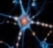

Difficulty of predictive techniques increases from classical single learners over advanced single learners to ensemble learning
Description
Best for
Challenges
Example application
Difficulty
Classical Single Learner
Predicts future event with a classical single technique, e.g., Linear/Logistic Regression, Decision Trees, Naïve Bayes
Getting quick transparent prediction with method that is easy to interpret
Quantifying effect of individual drivers on overall outcome
Results may have limited accuracy
Predict timing of maintenance needs for machinery based on performance data
Advanced Single Learner
Predicts future event with advanced single technique such as Neural Networks, Support Vector Machines, Elastic Net
Getting quick and defined single method
Quantifying effect of individual drivers on overall outcome
Results may have limited accuracy
Due to complexity, typically hard to interpret reason for predictions
Identify which process steps are best predictors of overall time taken for maintenance shutdowns
Ensemble Learning
Combines several learners to predict a future event with highest possible accuracy
Predicting a specific business event (e.g. churn) with highest possible accuracy
Improves predictions from single learners
Predictions come without a reason (“Black Box”)
Small data sets can quickly be overfitted
Predict competitive procurement pricing levels in a market with many external factors and “noise”
SOURCE: McKinsey Analytics Practice

Slide 22
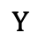
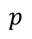
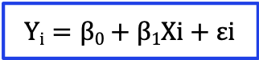
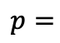
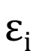

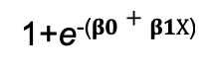
From Simple Linear Regression to Logistic Regression
$$Yi=β0+β1Xi+εi$$
$$Yi=β0+β1Xi+εi$$
Linear model
Y
$$Y$$
1
Observed value of Y for X_{i}
$$p$$
Logistic model
$$εi$$
Slope = β₁
1
$$p=$$
Predicted Value of Y for X_{i}
1+e⁻⁽$β0+β1X$⁾
Random Error for this X_{i} value
0
Intercept = β₀
X_{i}
X
X_{i}
X

Slide 23
Logistic regression is a simple model for binary dependent variables
What is it?
When dependent variable is binary – label falls in one of two categories
Logistic regression models the probability that Y belongs to a particular category
E.g., if predicting default:
might predict default if model gives a predicted probability >0.5
However we saw previously that this threshold can change
Why use it?
Output is transparent, easy to interpret and easy to implement which helps to get buy-in
Easy compliance with government regulations
?
When to use it?
When you have a clear hypothesis about what to solve
Data needs to be structured
Regulation requirement of clear model description
SOURCE: McKinsey Analytics Practice

